Slide 1
Renewable Energy Engineering
Module – II
https://sites.google.com/site/rejeeshcrfisat

Slide 2
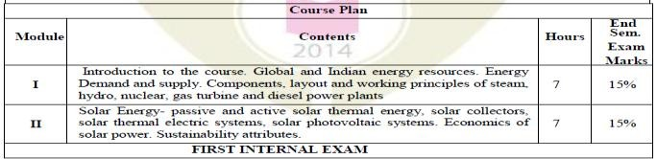
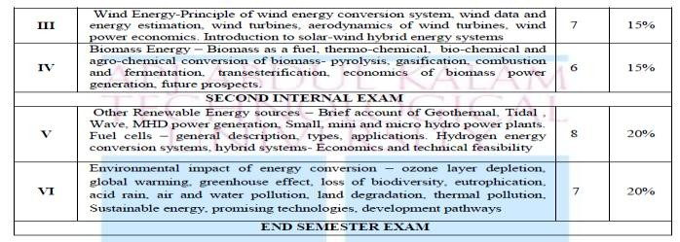
4

Slide 3
After successful completion of this course, students will be able to
Course Outcomes
Sl. NO | DESCRIPTION | PO MAPPING
1 | Discuss and compare the layout and working principles of steam, hydro, nuclear, gas turbine and diesel power plants. | PO1
2 | Describe the use of solar energy and the various components used in the energy production. | PO1
3 | Appreciate the need of Wind Energy and the various components used in energy generation and know the classifications. | PO1
4 | Acquire knowledge about the concept of power generation from biomass energy resources and their future prospects and economics. | PO1
5 | Describe the principles and applications of power generation from various sources and Hydrogen energy conversion systems. | PO1
6 | Understand energy scenario and the environmental effects of energy conversion and become aware of different renewable energy sources and choose sustainable energy for future. | PO1
3

Slide 4
Solar Power
Solar energy utilisation
Direct method
Indirect method
Thermal Photovoltaic Biomass Wind Wave energy OTEC Water power
Methods of solar energy utilisation
Direct method – The direct means include thermal (for direct heating, cooking, drying and power generation, etc.) and photovoltaic conversion (for direct electricity generation)
Indirect method – Indirect method means power generation from biomass, wind, wave energy, OTEC and water power.

Slide 5
Direct and Indirect Radiation
Direct radiation (beam radiation) is that part of terrestrial solar radiation reaching the earth's surface without a change in the direction as originated from sun. This radiation travels in straight parallel lines and as such, can be easily reflected or concentrated onto a small target area.
Diffuse radiation is that part of the terrestrial solar radiation reaching the earth's surface in all possible directions due to scattering by gases and dust in the earth's atmosphere. Because it comes from all directions of the sky dome, diffuse solar radiation cannot be efficiently reflected onto a target or concentrated.

Slide 6
Passive & Active Solar Systems
Active solar systems – Active solar power setups rely on external energy sources or backup systems, such as pumps, valves, controllers to capture and circulate water or other heat- transfer fluids through the collectors and then convert solar energy into electricity.
The components in active solar systems such as fans, pumps, photovoltaic panels need some electrical input or conversion for the system to function.
Active systems are usually more expensive than passive systems, they are generally more efficient.
Passive solar systems – Passive solar technologies are means of using sunlight for useful energy without use of active mechanical systems such as pumps to circulate water/fluid between collector and storage medium. In passive thermo siphon systems the storage medium is mounted above the collector. This set-up makes it possible to use gravity for circulation.

Slide 7
Terms and definitions involved
Solar insolation (incident solar radiation) – Solar radiation received on a flat horizontal surface on earth at a particular instant of time.
Concentration ratio – ratio of the aperture area divided by the receiver/absorber area of the collector
Flat plate collector = 1 CR,
parabolic trough collector = 100 CR,
heliostats with 2 planes = 1000 CR can be achieved.

Slide 8
Solar Collectors
Solar collectors gather the sun's energy, transform its radiation into heat, then
transfer that heat to a fluid. This heat is extracted by flowing fluid (usually air,
Aperture
Rceiver
water or oil) in the tube of the collector for further utilization in different applications.
Solar collectors are classified as
Non concentrating collectors
Concentrating (focusing) collectors
Concentrating ratio of collector
The main reason for using concentrating collectors is that the thermal energy is obtained at higher temperatures. This is done by decreasing the area from which heat losses occur (called the receiver area) with respect to the aperture area (i.e., the area facing or intercepts the solar radiation).
The ratio of the aperture to receiver area is called the
concentration ratio.

Slide 9
Non concentrating collectors
In non concentrating collectors, the aperture area to intercept the solar radiation is equal to the absorber plate and thus has the concentration ratio equal to 1.
Flat plate collectors (FPC) and evacuated tube collectors (ETC) are non-concentrating type collectors.

Slide 10
Flat Plate Collector
Advantages of flat plate collectors
Since flat-plate collectors absorb energy coming from all directions above the absorber, tracking is not required and hence it is simple in design and requires less maintenance.
It utilizes the both the beam as well as diffuse radiation for heating.
Disadvantages of flat plate collectors
As low temperature is achieved, flat plate collectors are not used for power generation.
Large heat losses by conduction and radiation because of large area.
Applications of flat plate collector
Solar water heating systems for residence, hotels, industry.
Solar cookers for domestic cooking.
Drying applications.
Residence heating.

Slide 11

Flat Plate Collector
Transparent covers
Diffuse solar radiation
Direct solar radiation
Air space Insulation
Fluid tube
Absorber plate
Flat plate solar collector
Tubes – The absorber plate is attached to a series of parallel tubes through which water or other liquid passes. The tubes are usually made of copper, aluminum or steel.
Insulation beneath the absorber plate – It minimises and protects the absorbing surface from heat losses.
Box structure – It contains the above components and keeps them in position.

Slide 12
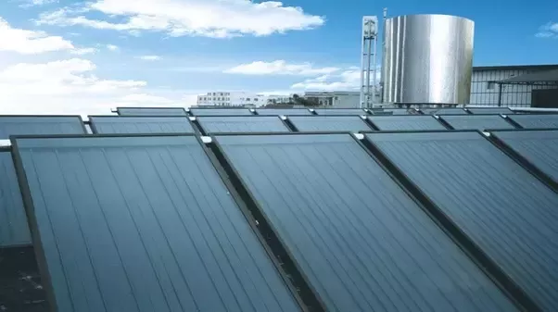
Flat Plate Collector

Slide 13

Direct flow evacuated tube collector
This type consist of a group of evacuated glass tubes inside each of which is a flat or curved thermal conducting
Cold water in
Solar radiation
Evacuated tube
^{Seal} Aluminum fin
plate (aluminium fin) attached to a metal (usually copper) or glass pipe.
Direct flow evacuated tube solar collector
Hot water out
The inner surface of the evacuated glass tube has a selective coating that absorbs solar radiation and prevents radiative loss. The heat transfer fluid is water and circulates through the pipes, one for inlet fluid and the other for outlet fluid.
Since the heat transfer fluid flows into and out of each tube, direct flow evacuated tube collectors are not as flexible as the heat pipe types.

Slide 14
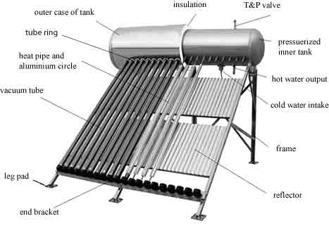
evacuated tube collector

Slide 15
Heat pipe evacuated tube collector
Manifold
Solar radiation
In this type, a copper coated absorber plate is bonded to a sealed copper heat pipe.
Condenser Vapour rises
^{Copper plate} Evacuated tube
Alcohol liquid
Condensed liquid returns to the bottom
Fluid flow
Heat pipe
Heat pipe evacuated tube solar collector
The heat pipe contains a working fluid (alcohol) at low pressure. When the heat pipe is heated, the liquid turns into a vapour, rises within the pipe to a condenser that is in contact with the heat transfer fluid in the manifold.
At the condenser the vapour condenses back into a liquid, releasing the latent heat.
The liquid then returns back down the heat pipe where it is heated, evaporates and once more repeats the cycle.

Slide 16




Concentrating (focussing) collectors
Reflector Absorber
Focal line
Parabolic trough collector Parabolic dish collector
Concentrating collectors intercept direct radiation over a large area and focus it onto a small absorber area.
The collector in concentrating type consists of a concentrator and a receiver.
Receiver is a device that is able to convert the solar radiation into a different kind of energy. This can be either a heat absorber (to harvest thermal energy) or a photovoltaic cell (to convert solar radiation to electric energy).

Slide 17
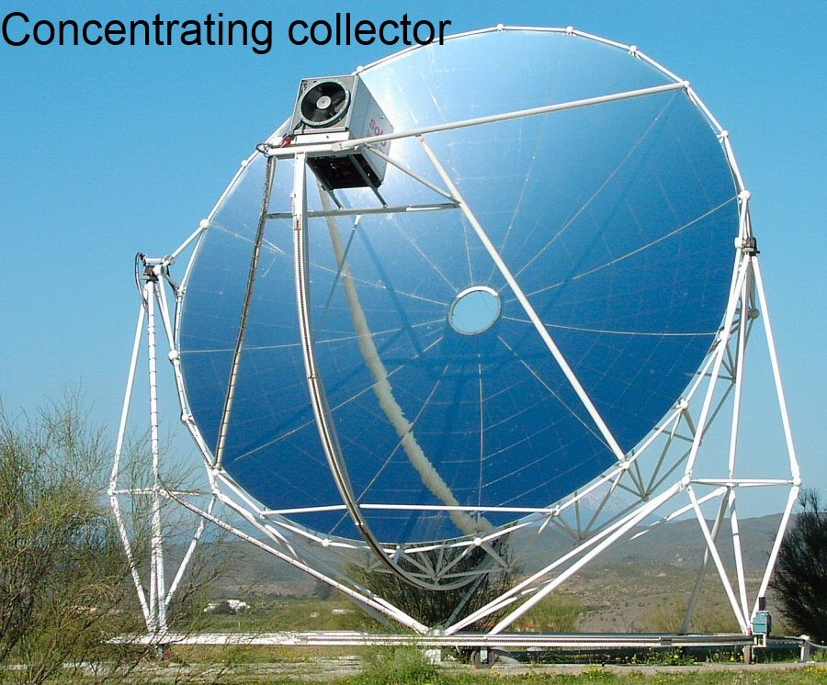
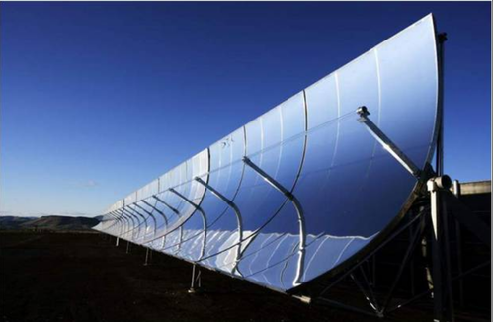
Concentrating (focussing) collectors

Slide 18
Comparing flat plate collector (FPC) & Evacuated tube collector (ETC)
Sl. No. | Flat plate collector (FPC) | Evacuated Tube Collector (ETC)
1. | In flat plate collector an absorber plate with a sheet of copper, painted or coated black is bonded to pipes of transfer fluid. | Evacuated tube collector a glass tube with vacuum inside it is surrounding an absorber plate or area.
2. | FPC has low cost. | ETC has higher cost.
3. | Flat plate collector is more efficient than evacuated tube collector at ambient temperature. | ETC is more efficient than FPC at lower working temperatures (conditions).
4. | The design of FPC is easy. | The design of ETC is difficult because of vacuum inside the tube.
5. | FPCs are sensitive to sun angle and orientation. | ETCs are less sensitive to sun angle and orientation.
6. | FPCs have longer life. | ETCs have less life than FPCs.

Slide 19

Parabolic trough collector
The parabolic trough collector is of
line focussing type solar collector.
It is having the shape of a cylindrical parabola.
It focuses the sunlight onto its axis where it is absorbed on the surface of the absorber tube and transferred to the fluid flowing through it.
Reflector
Absorber
Focal line
Parabolic trough collector
Cylindrical parabolic collector usually offer temperatures between 150°C and 400°C with concentration ratio between 10 and 80, and are generally used for generating steam for electricity generation.

Slide 20


Parabolic dish collector
The paraboloic dish collector is of point focussing type solar collector. For point focussing type, the receiver is placed at the focus point of the concentrator.
In this case, the tracking system is provided to track the sun automatically for all times.
These collectors can have concentration ratio ranging from 100 to a few thousand.
Around 2000°C temperature can be achieved by this collector and are used for generating steam for electricity generation.

Slide 21
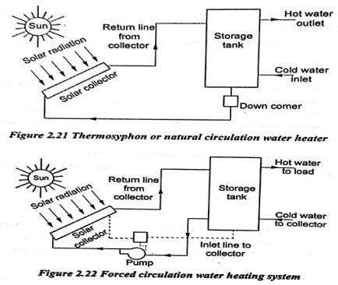
Solar Water Heater

Slide 22
Solar thermal electric systems
Solar direct thermal applications involve the direct use of heat for various applications like,
Solar water heater
Solar Cooker
Solar Crop dryer
Solar Distillation or Solar still
Solar Pumping
Solar Space heating
Solar Space cooling
Solar furnace

Slide 23
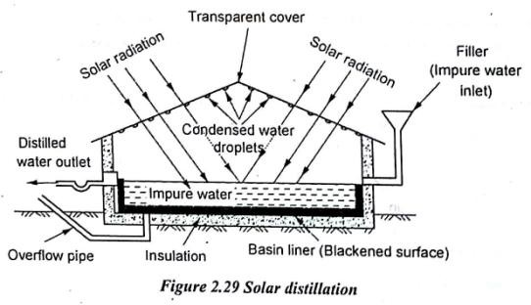
Solar Distillation or Solar still

Slide 24
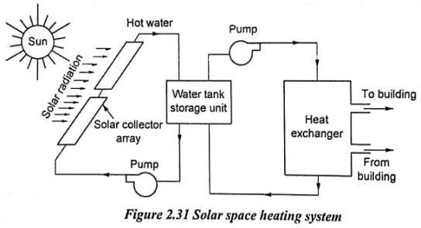
Solar Space heating

Slide 25
Solar thermal power generation
Solar thermal electric power plants generally use concentrated sunlight obtained through various mirror configurations to focus the sun‟s energy to produce high temperature heat.
The heat energy is then transferred to a fluid or gas, which is used in a typical power plant cycle to convert the heat energy to mechanical energy and then electricity.
Solar thermal power cycles can be broadly classified as low, medium and high temperature cycles.
Most of the solar thermal power generation works based on
Rankine cycle.
The Rankine cycle system consists of a pump, boiler, turbine, and condenser.

Slide 26
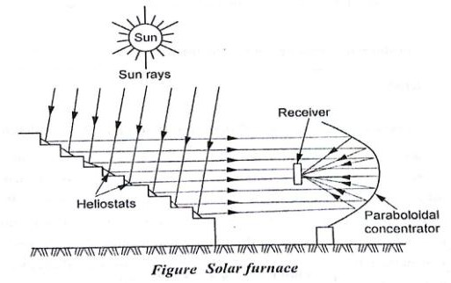
Solar furnace

Slide 27


Low temperature thermoelectric power generation
Vapour generator
Turbine
^{Reflector} Storage tank
Condenser
Flat plate collector
with reflectors
Working fluid
Pump
Pump
Low temperature solar power generation
The hot water at about 100°C is stored in a well-insulated thermal storage tank. It then flows through a vapour generator/evaporator where the organic working fluid is vapourized at about 90°C.
The vapour then flows under pressure to the turbine where it expands and work thus obtained runs an electric generator producing electricity.

Slide 28

Medium temperature thermoelectric power generation
Temperatures around 150°C to 300°C can be attained by using array of parabolic trough collectors (line focusing).
Parabolic trough collectors concentrate sunlight onto a receiver tube, placed along the focal line.
Reflector Absorber
Focal line
Parabolic trough collector
The fluid flowing through the absorber tube absorbs the heat and is then drawn through a heat-exchanger in which it transfers heat to high pressure water which is converted to steam which executes a Rankine cycle.

Slide 29
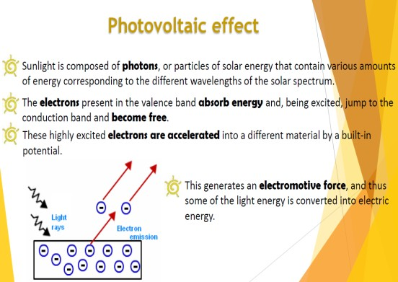

Slide 30
Solar photovoltaic systems
Photovoltaic energy conversion (PV) is a direct conversion technology that produces electricity without the use of a thermodynamic cycle or a working fluid.
The basic unit of a photovoltaic system is the photovoltaic cell, also called solar cell that directly converts solar radiation into electricity. It is based on the photoelectric (or photovoltaic) effect.
This effect is exhibited by materials called
semiconductors (such as silicon).

Slide 31
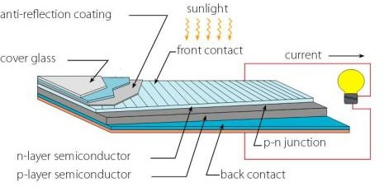
Basic structure of a SOLAR CELL

Slide 32
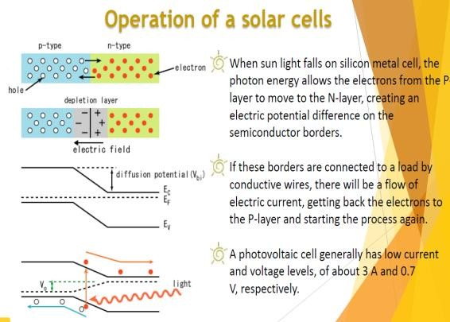

Slide 33
Photovoltaic conversion
Extra
Missing electron
or hole
electron
Phosphorus
Boron
Silicon doped with phosphorus Silicon doped with boron
If the silicon is doped (doping-introduction of impurities into the semiconductor crystal to change its conductivity) with a small quantity of an element that has five valence electrons in an atom and it can fit into the silicon crystal structure (such as phosphorus/arsenic), some extra electrons are created (as the fifth valence electron does not create a covalent bond). Such a doped material is called an n-type semiconductor, because the extra electrons carry a negative charge.
Alternatively, if the semiconductor is doped with an element that has only three valence electrons (such as boron/gallium) absence of an electron in a covalent bond or holes, are created. This is a p-type semiconductor.

Slide 34
Photovoltaic conversion
But for the production of electricity, the actual solar cell device must be made from two different types of so-called
„doped‟ semiconductors.
In a normal silicon crystal, there are four valence electrons in every atom. They are held in place by the positive charge from the nuclei of the silicon atoms. Each silicon atom shares each of its four valence electrons with another nearest silicon atom hence creating covalent bonds between them.
When a pentavalent impurity like phosphorus is added to silicon, the 4 valence electrons of each phosphorous atom is shared through covalent bonds with 4 neighboring silicon atoms, and 5th valence electron does not get any chance to create a covalent bond. This 5th electron is then relatively loosely bounded with its parent atom.

Slide 35

Photovoltaic conversion
Depletion layer
n-type
p-type
Fixed impurity charges
p-n junction
An electric field is thus created with ions, across the junction. Normally, however, there is equal flow of carriers(electrons from n region to p region and holes from p region to n region) in both directions across the junction and no electricity can be produced.
This process continues until the electrical charge created at the junction by the ions repel or prevent any more carriers from crossing the junction. Eventually a state of equilibrium (electrically neutral situation) will occur producing a ‘potential barrier’ zone around the area of the junction as the positive ions repel the holes and the negative ions repel the electrons.

Slide 36

Photovoltaic conversion
Depletion layer
n-type
p-type
Fixed impurity charges
p-n junction
Since no free charge carriers can rest in a position where there is a potential barrier it is therefore „depleted‟ of any free mobile carriers, and this area around the junction is now called the Depletion Layer. This region which is “stripped” of carriers is called the depletion region
When solar radiation strikes the solar cell, excess electrons flow from the n-type material to the p-type material and excess holes
„flow‟ in the opposite direction. This, together with the existence of the electric field across the junction, makes possible the flow of electrons away from the junction and through an external circuit. This flow of carriers causes electric current flow. Thus, solar energy is converted into electricity.

Slide 37
Polycrystalline solar cells
Polycrystalline solar cells are made by pouring molten silicon into square molds, where it cools and solidifies for use in a solar panel.
Because there are many crystals
in each cell, there is less freedom _{Polycrystalline panel}
for the electrons to move.
As a result, polycrystalline solar panels have lower efficiency ratings than mono-crystalline panels.
Polycrystalline solar cells have blue colour with square shape.

Slide 38
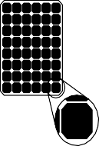
Mono-crystalline cells
Mono-crystalline cells are made by slicing a single higher grade silicon rod into wafers.
Cells are then made to fit into one solar panel. Because the cell is composed of a single crystal, the
electrons that generate a flow of electricity have more room to move.
Mono-crystalline panel
As a result, mono-crystalline panels are more efficient than their polycrystalline counterparts.
Mono-crystalline solar panels have the highest efficiency rates (around 20%) since they are made out of the highest-grade silicon.
They are distinguished by uniform dark colour with rounded edges.

Slide 39
Comparing mono-crystalline, polycrystalline & thin film solar panels
Aspect | Mono-crystalline | Polycrystalline | Thin film
Efficiency | More efficient. | Less efficient. | Less efficient.
Space requirement | Less space needed | More space needed | More space needed
Cost | Costly | Cheaper | Cheaper
Efficiency in warm low light | Better | Low efficiency | Better.
Life | Longer life. | Shorter life | Shorter life
Colour | Black. | Blue. | Dark surface with brown/black colour

Slide 40
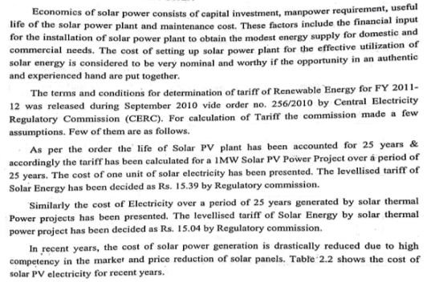
Economics of Solar Power

Slide 41
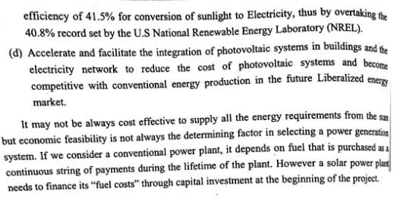
Economics of Solar Power

Slide 42
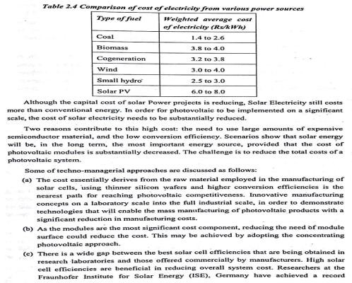
Economics of Solar Power

Slide 43
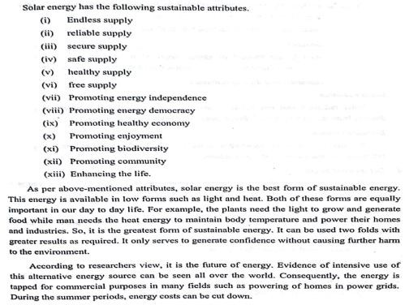
Sustainability Attributes

Slide 44
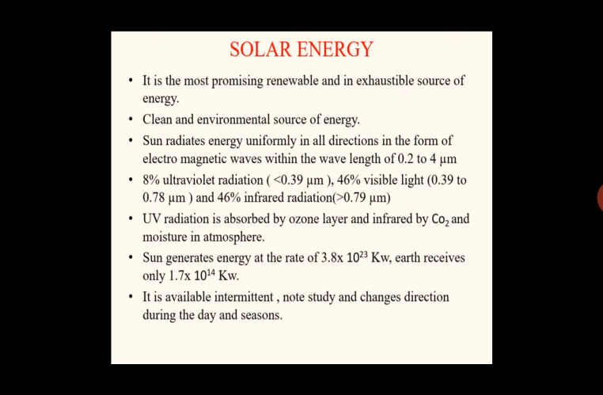

Slide 45
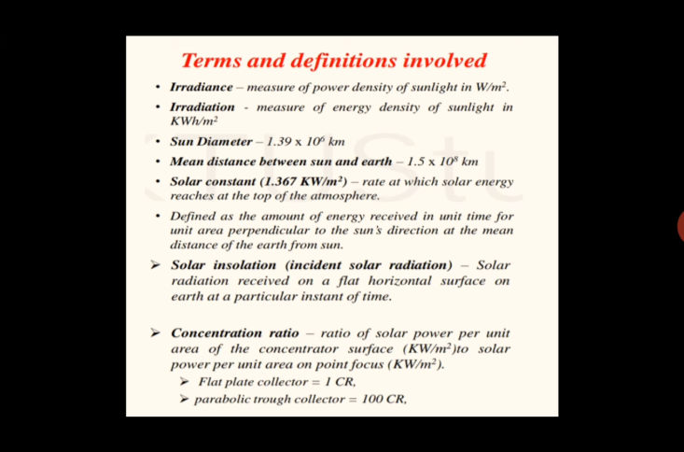

Slide 46
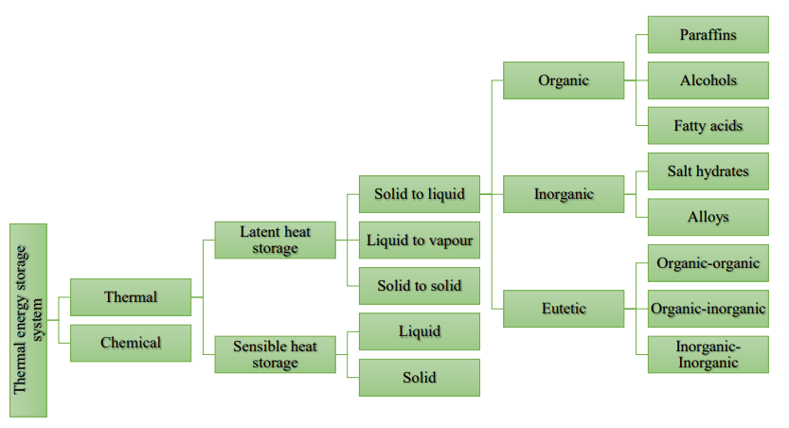
Thermal energy storage system

Slide 47
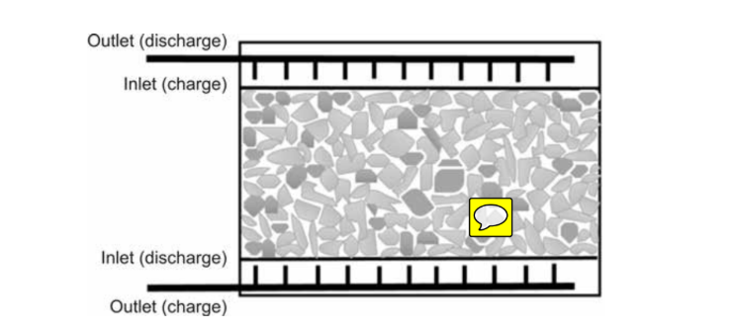
Sensible Energy Storage

Slide 48
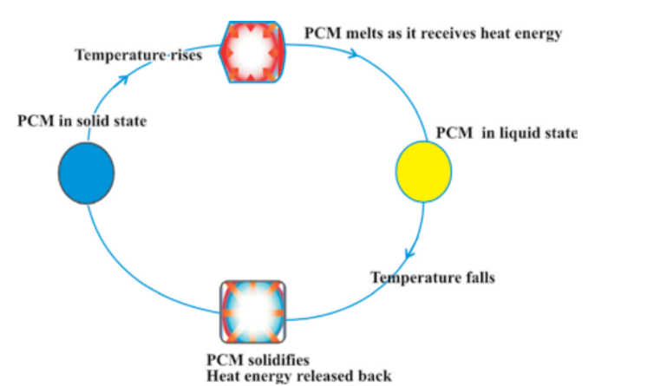
Phase Change Materials Energy Storage

Slide 49
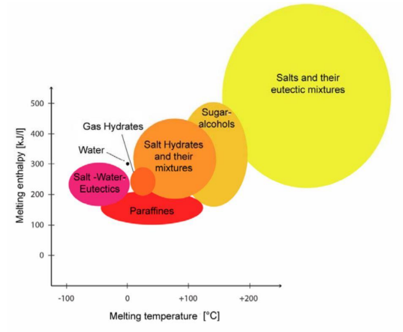
Phase Change Materials Energy Storage

Slide 50
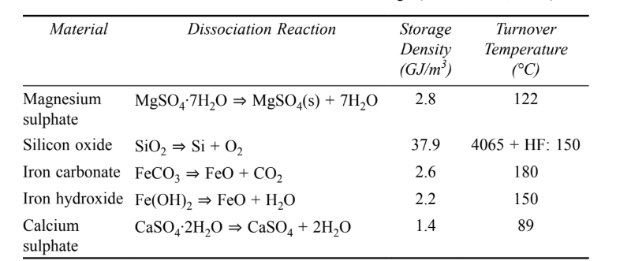
Chemical energy storage

